Slide 1
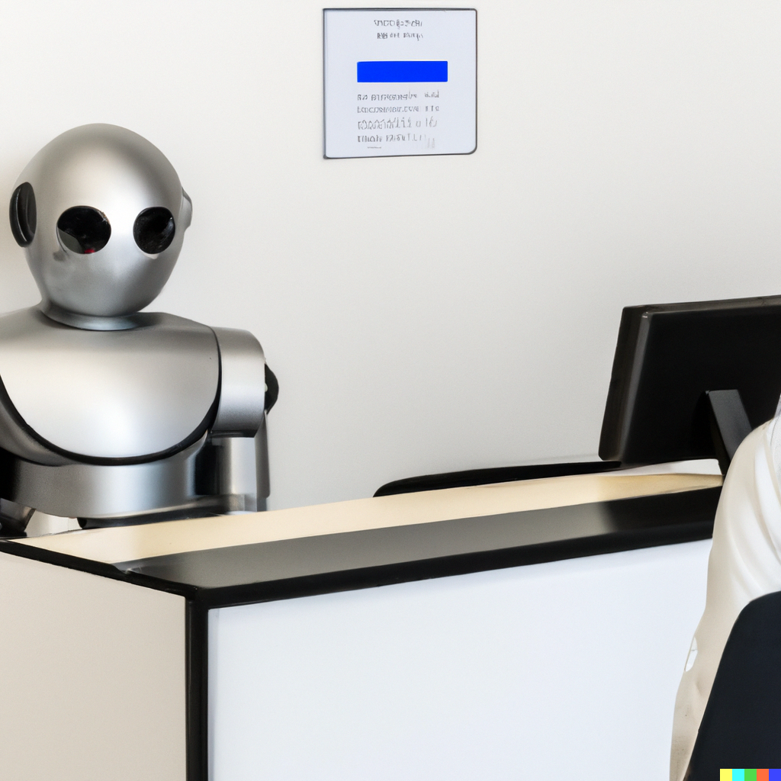
A Study of Adoption of Cloud computing and AI/ML in FinTech
Sumitranandan Kamarajugadda

Slide 2
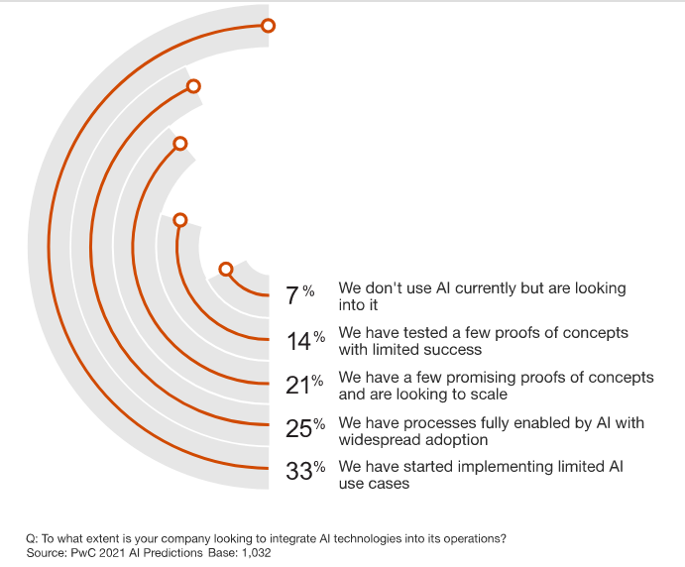
Introduction
Generative AI
Learns a digital representation of artifacts from data and generates innovative new creations like the original but do not repeat it
Autonomic Systems
Self-managed software systems that learn from environments and modify their own algorithms in real-time.
Privacy-Enhancing Computation
PEC secures the processing of personal data in untrusted environments
Gartner reveals top three tech trends for banks in 2022
PWC poll on AI adoption

Slide 3
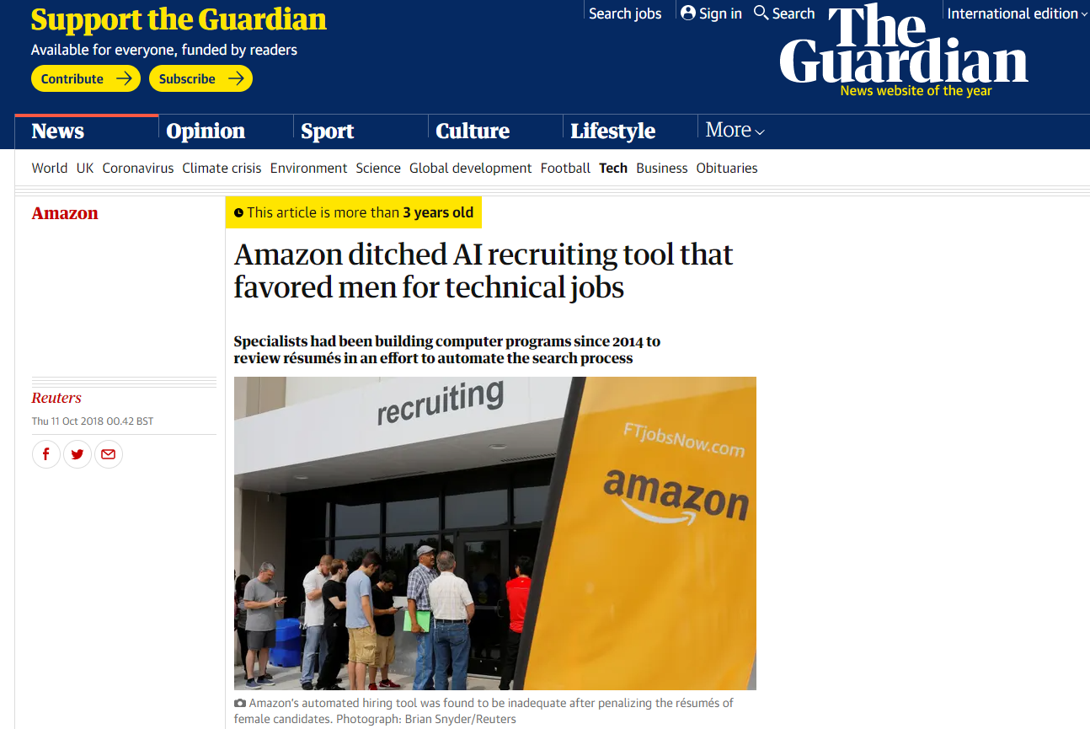
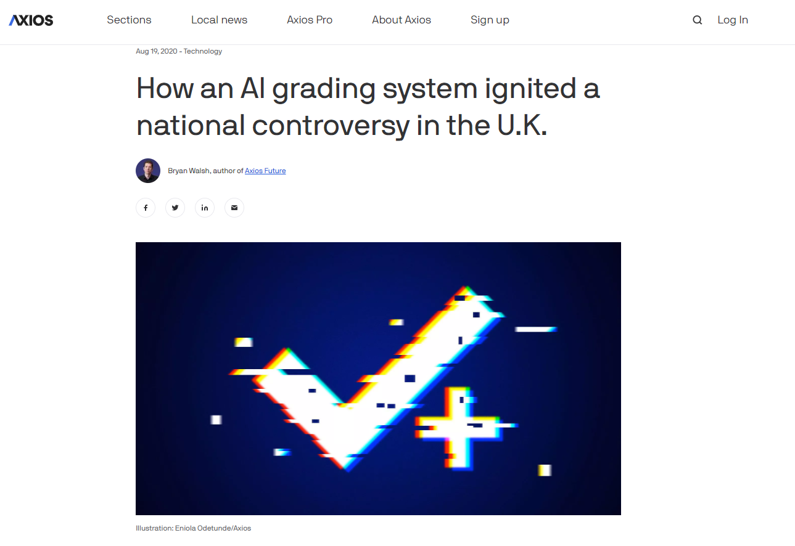
Background

Slide 4
Background

Slide 5


Customer experience

Slide 6
Questions
How does FinTech Industry use technology?
What is the role of cloud computing?
What is the use of Machine learning and AI?
Why do some AI implementations fail?
Why do algorithms show bias?
How do we identify a potential bias?
How to minimize/eliminate these biases?

Slide 7
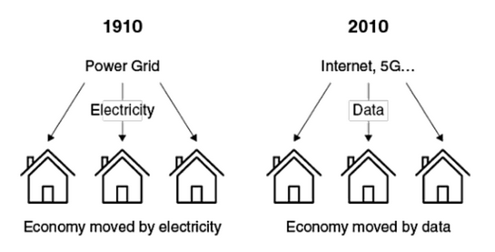
Literature review
MICROSERVICES
DIGITAL MARKETING
CHATBOTS
DATA COLLECTION
GDPR
FRAUD DETECTION
SAAS & PAAS OFFERINGS
Role of data in economy

Slide 8
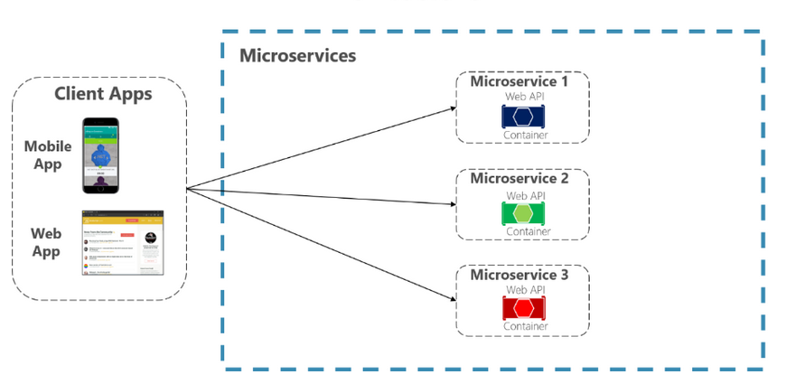
Microservices
In-person services
Self-service

Slide 9
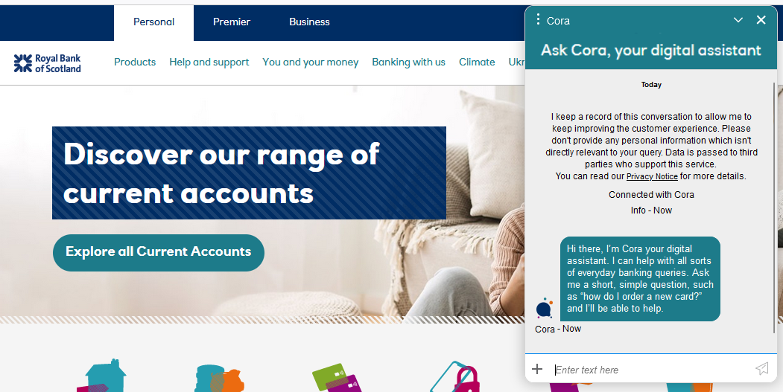
Chatbots

Slide 10
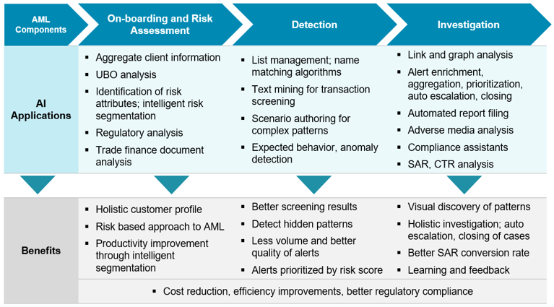
Customer screening & Credit risk

Slide 11
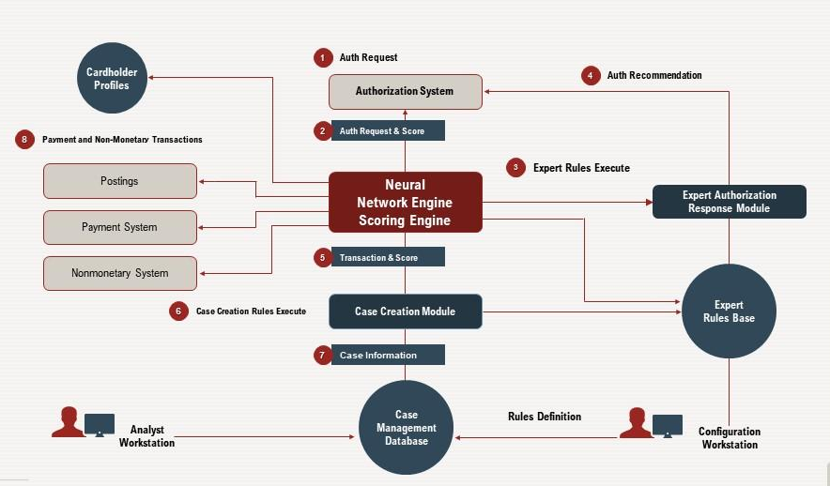
Fraud detection

Slide 12





Digital marketing
Cookies & trackers
Data brokers
Microservices
Ads & Offers

Slide 13
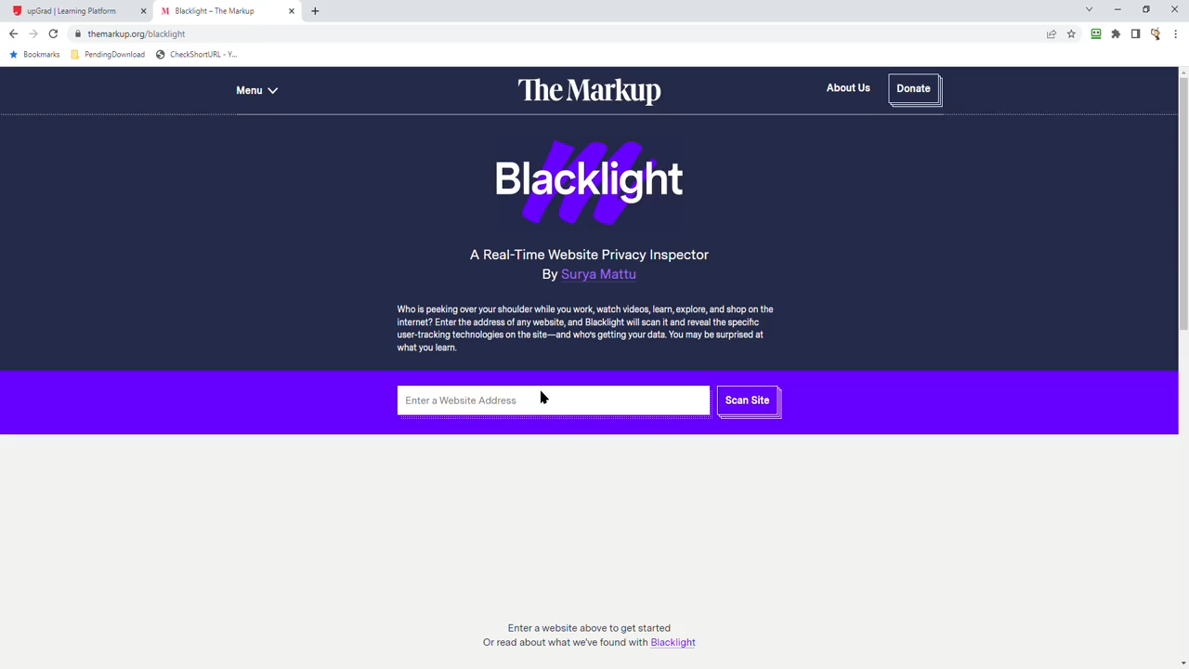
Data collection & GDPR

Slide 14
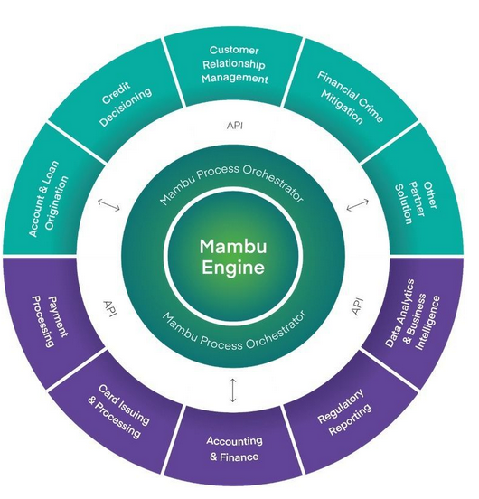
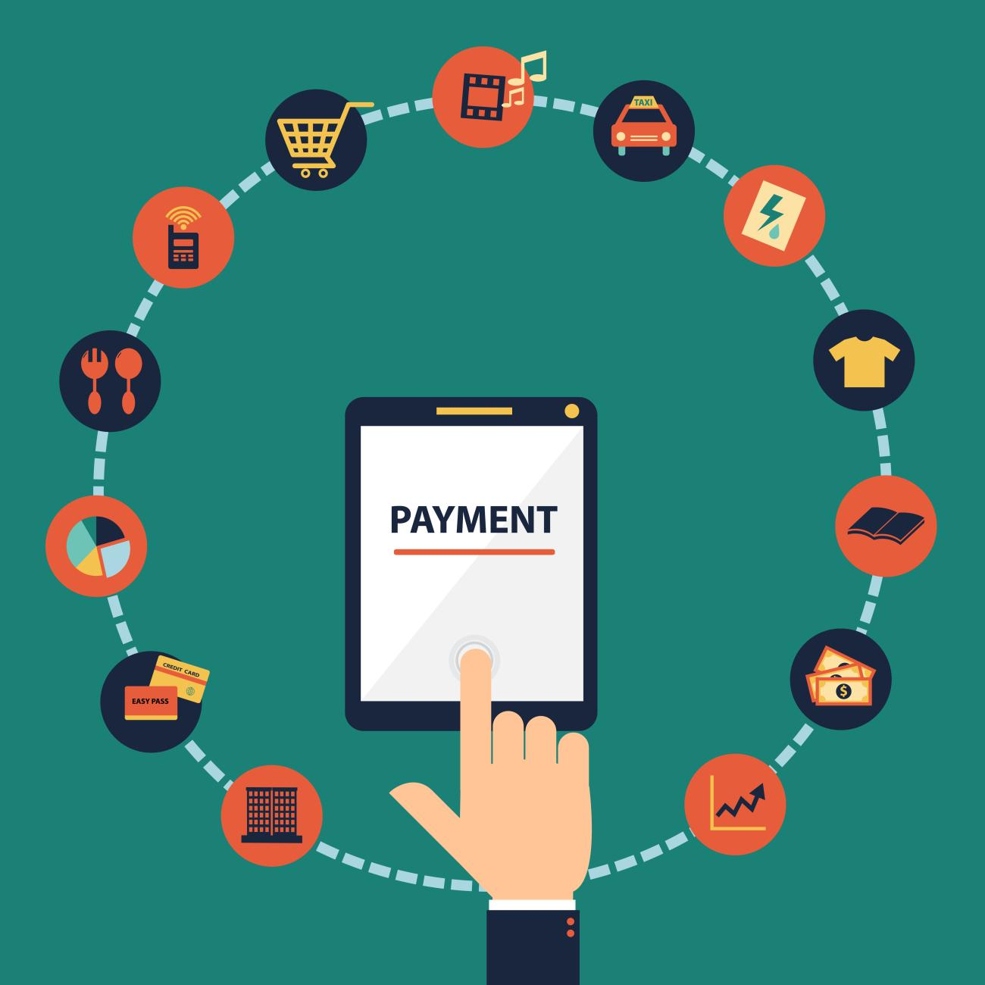
SaaS and PaaS offerings
SaaS
PaaS

Slide 15
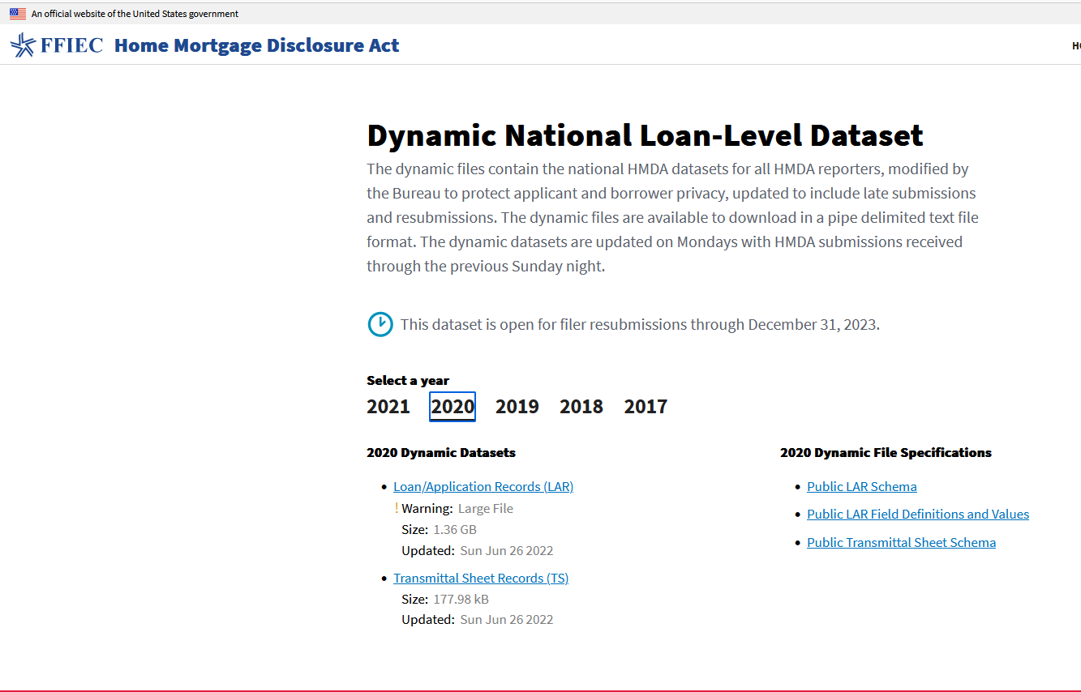
Dataset
https://ffiec.cfpb.gov/data-publication/dynamic-national-loan-level-dataset/2021
Important variables
Race and Ethnicity
Sex
Co-applicant
Age
Income
Loan Amount
Property Value Ratio
Mortgage term
Credit Model
Debt-to-Income Ratio

Slide 16
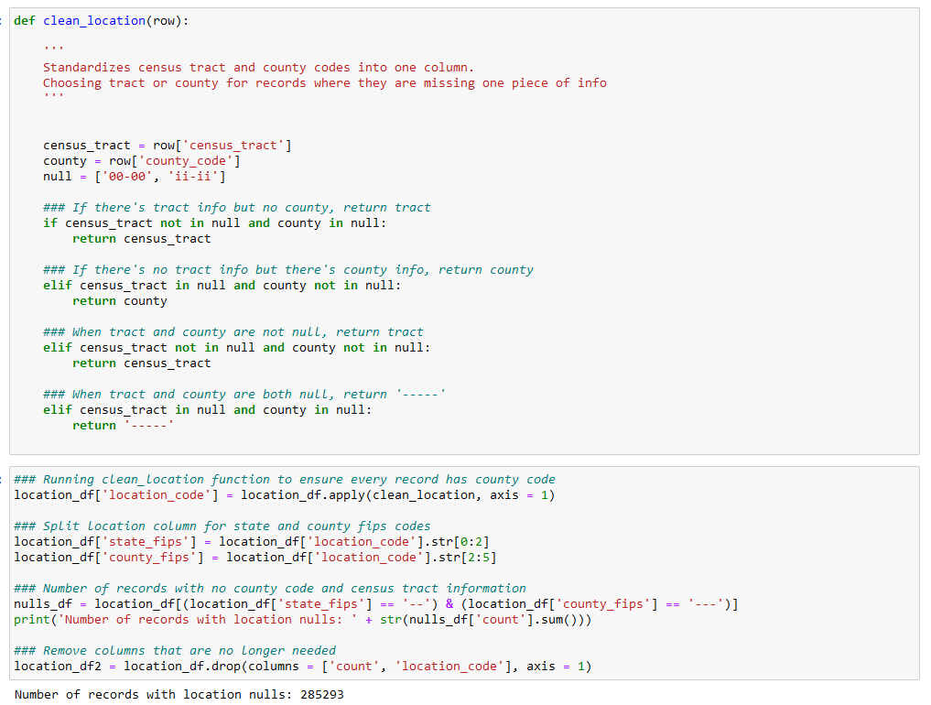
Data cleansing & standardising
26204358 records
99 Columns
Year 2021
Clean-up of Nulls and identify not applicable categories

Slide 17
Data cleansing II
Remove outcomes other than Approval and Rejection
Remove data where the following are missing
Ethnicity
Gender
Outcome
Age
Debt-To-Income ratio
Filter only residential loans

Slide 18
Data categorization
Lender categorization
Location categorization into metro and non-metro
Location categorization with a race gradient with percentage of minorities
Categorize Debt-to-Income ratio into buckets
Categorize age into buckets

Slide 19
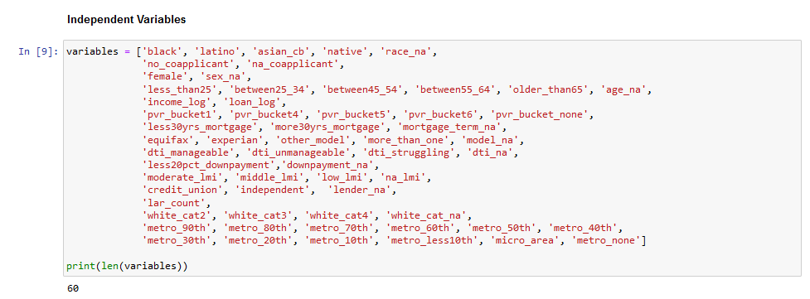
Independent variables

Slide 20
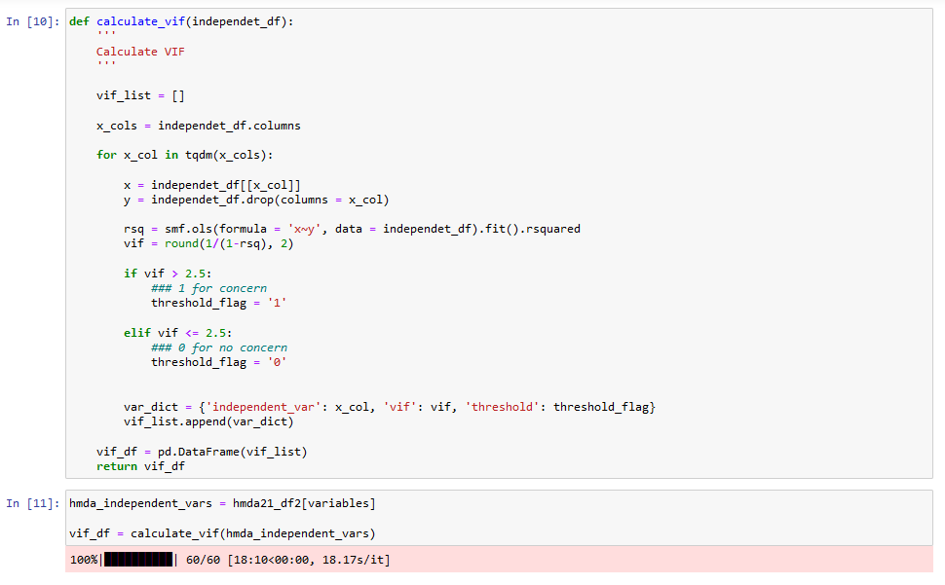
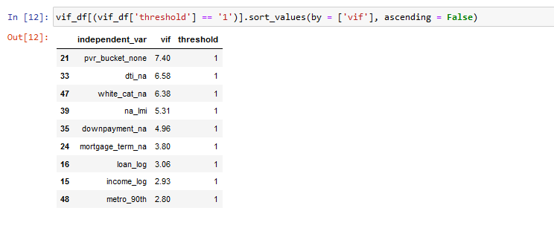
Collinearity test

Slide 21
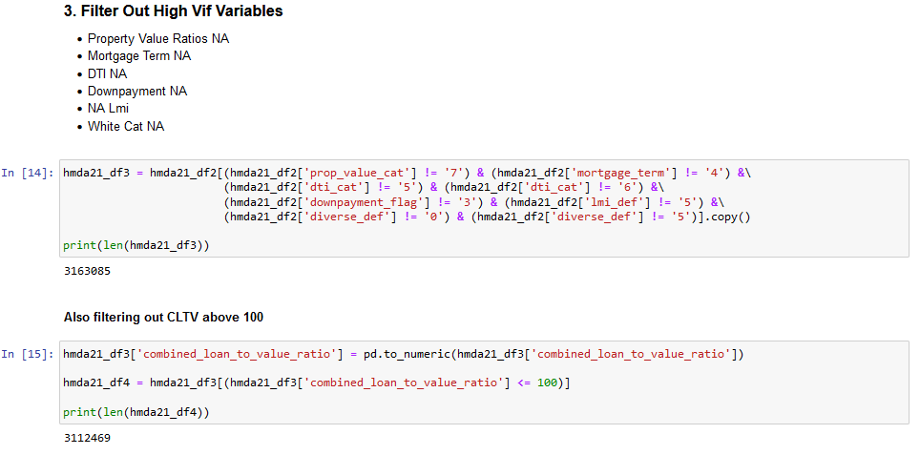
Clean variables with high VIF

Slide 22
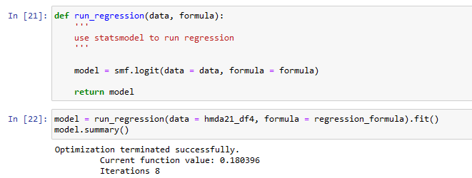
Regression
Parameter | Value
Dep. Variable: | denied
Model: | Logit
Method: | MLE
Date: | Sat, 13 Aug 2022
Time: | 21:19:36
converged: | TRUE
Covariance Type: | nonrobust
No. Observations: | 3112469
Df Residuals: | 3112417
Df Model: | 51
Pseudo R-squ.: | 0.219
Log-Likelihood: | -561480
LL-Null: | -718940
LLR p-value: | 0

Slide 23
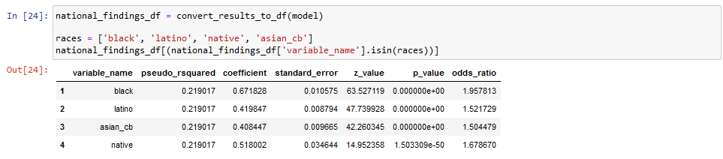
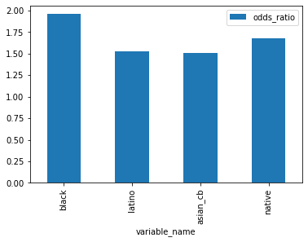
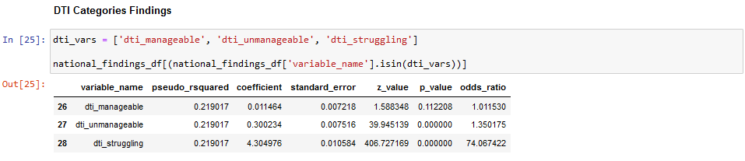
Regression findings
Black applicants are almost twice as likely to be denied
Latinx/Hispanic are almost 1.5 times
Native Applicants are 1.7 times
Asian/Pacific Islander are 1.5

Slide 24
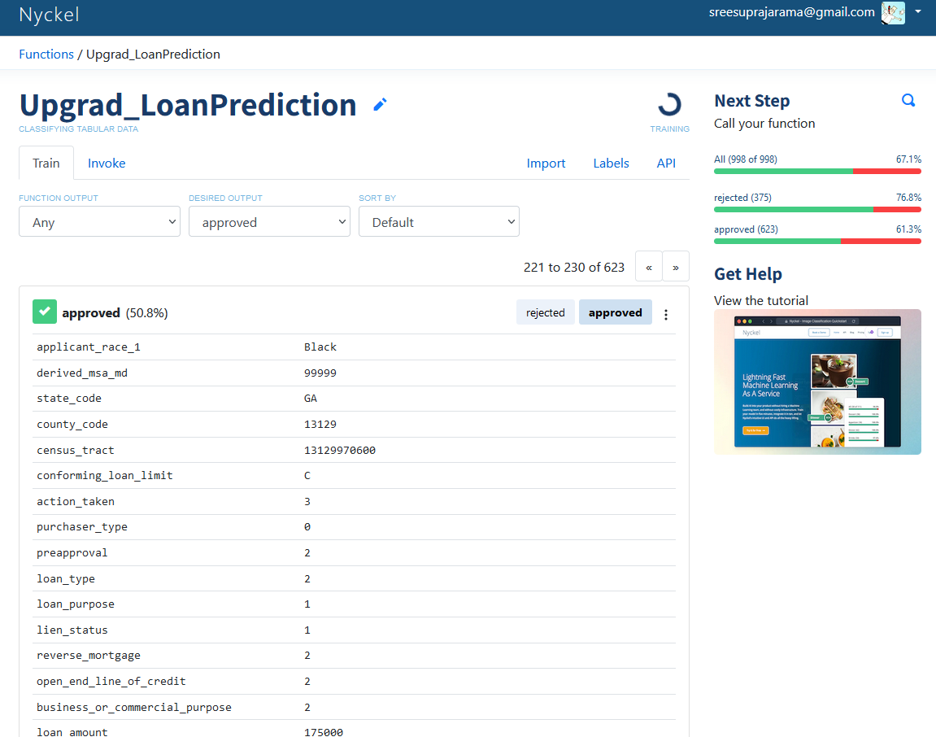
Nyckel - Train and test
A percentage of this dataset was used to train an unsupervised AI model building cloud hosted platform called Nyckel.

Slide 25
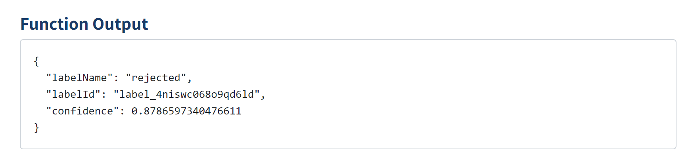
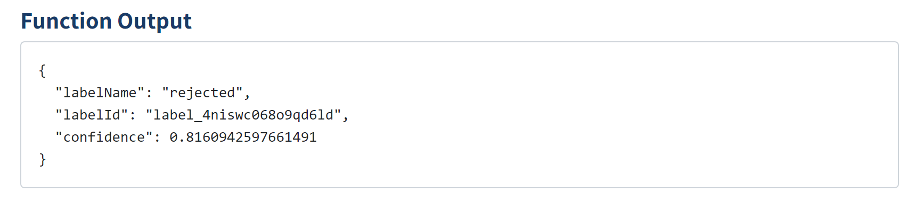
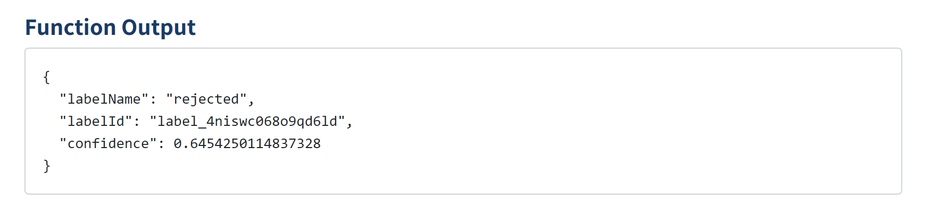
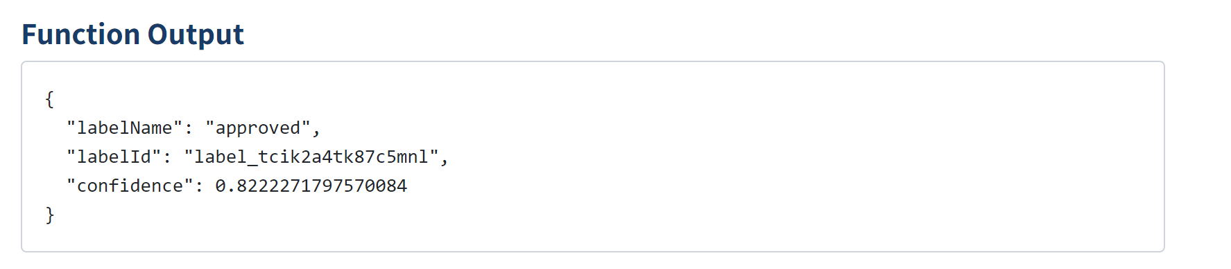
Nyckel – Test results
A test was done with used a sample set of data varying only the race column and keeping all the other data constant.
The biases in real world were represented in the dataset and were then transferred to the AI model during training.
Black
Native
Asian
White

Slide 26
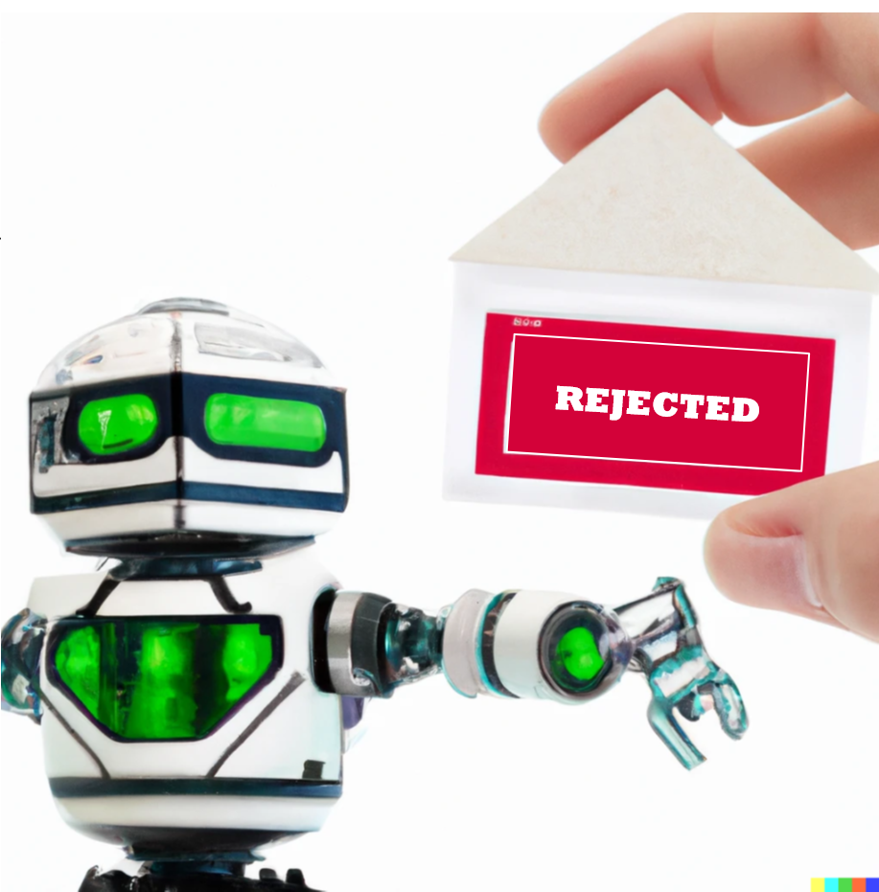
Recommendations & Future scope
Recommendations
Any independent variables that are not relevant to the regression should be omitted
Personal data such as age, gender, race should be used only when they are relevant to the application
Domain experts should be involved in validation and verification of a model
For models trained with data streams, periodic validation should be done to ensure biases are not introduced.
Future scope
The study can be expanded to see if the demographics of the location also have an impact on outcome.
There is a need for legislative control to regulate the use of technology in industries that have high impact on lives of people.
A review needs to be done of the deviation of existing criteria for a loan approval.
There should be an effort to develop explainable, transparent AI systems

Slide 27
Thank you

